Slide 1
Lung cancer Detection in its early stage using TransUNet.
BATCH - A03
GUIDE : DR. V. RAMESH BABU
PRESENTED BY,
M AKASH KRISHNAN - 221191101006
J DHANESH - 221191101035

Slide 2
Problem Statement
Lung cancer is the leading cause of cancer-related deaths, largely due to late-stage diagnosis.
Although 3D CT scans are effective for early detection, manual interpretation of massive spatial volumes is slow, prone to cognitive fatigue, and varies between radiologists.
Existing AI models often struggle with either fine-grained local texture analysis or the global contextual understanding needed for highly accurate diagnosis.
There's a lack of explainable, multi-modal ensemble models—combining CNNs, ResNets, and Vision Transformers—that can perform both pixel-perfect segmentation and precise classification of lung nodules in a clinically meaningful way.
A robust, automated, and interpretable clinical dashboard is needed to assist radiologists in detecting early-stage lung cancer with high baseline precision, rapid computational speed, and absolute diagnostic transparency.

Slide 3
Existing System
Traditional diagnosis of lung cancer relies on manual evaluation of massive volumetric CT scans by radiologists, which is time-intensive and prone to human error.
Conventional machine learning models require hand-crafted features and lack the ability to automatically extract deep, complex spatial hierarchies and edge morphology across diverse patient data.
Standard 2D and 3D CNN-based segmentation models (like U-Net) can detect lung nodules but often fail to capture the global context and long-range dependencies that Vision Transformers (ViTs) successfully resolve.
Classification and segmentation are often handled separately, leading to disjointed pipelines and a lack of unified, dual-task ensemble models that can simultaneously predict malignancy and generate pixel-perfect boundary masks.
Few existing systems provide visual explanations or trustworthy AI outputs, creating a critical need for an interpretable clinical dashboard that delivers multi-planar reconstructions, exact segmentation overlays, and sensible confidence scaling for radiologists.

Slide 4
Literature Survey
Year | Paper Title | Problem Statement | Proposed Solution | Research Gap
2025 | A hybrid CNN-transformer model for predicting N staging and prognosis of NSCLC | Accurate N-staging assessment in NSCLC patients is vital for treatment planning and survival but relies on invasive pathology or limited imaging, with traditional methods struggling on small lesions and needing non-invasive precision. | A hybrid 3D CNN-Transformer model extracts local (CNN) and global (Transformer) features from CT scans for N-staging prediction and Lasso-Cox-based survival analysis (1-7 years), achieving ~82% accuracy across sets. | Pure CNNs miss global context; pure Transformers overlook local details.
2025 | Dual-branch feature fusion S3D V-Net network for lung nodules segmentation | Lung nodule segmentation accuracy is hindered by heterogeneity, edge blurring, pixel imbalance, and inadequate 3D structural use in 2D/3D models. | A 2.5D S3D V-Net with dual-branch feature fusion (DFFM), reverse attention (RACM), separable 3D convolutions, and central pooling fuses intra/inter-slice features for precise edge segmentation | Existing 2D/3D/2.5D models suffer high computation, info loss, or poor edge handling; limited multi-scale fusion and attention for complex anatomies/noise.
2024 | A multi-task model for pulmonary nodule segmentation and classification | Single-task deep models ignore segmentation-classification correlations, limiting performance in lung cancer CAD for nodules. | MT-Net: shared backbone with Coarse Seg-net (location prior), Class-net, Fine Seg-net, and prediction distillation for joint tasks (DI 83.2%, ACC 91.9% on LIDC-IDRI). | Task silos overlook mutual benefits; no unified models exploiting correlations via distillation/priors

Slide 5
Literature Survey
Year | Paper Title | Problem Statement | Proposed Solution | Research Gap
2024 | Fusion networks of CNN and transformer with channel attention for lung nodule detection | Lung nodule detection needs better boundary perception amid varying scales/shapes via limited CNN/Transformer fusion. | Dual-branch CNN-Transformer fusion with channel attention, CFM/SFM for multi-scale features and EGFR prediction. | Static fusions fail diverse nodules; lacks adaptive channel/spatial attention for detection/segmentation.
2024 | Accurate classification of lung nodules on CT images using the TransUnet | Doctor-dependent CT nodule classification is subjective, time-intensive, error-prone for tiny nodules, with high false positives. | TransUnet: Transformer encodes global features from patches; U-Net decodes for localization; GAP classifies benign/malignant (ACC 84.62%, AUC 0.862 on LIDC-IDRI). | Manual features limit automation; early DCNNs miss global modeling for complex backgrounds/tiny objects.

Slide 6
Design Methodology
Data Collection: The LUNA16 dataset will be used, utilizing massive 3D CT scans (.mhd format) and precise coordinate mapping via metadata.
Preprocessing: World-to-voxel coordinate translation via SimpleITK, extraction of highly localized (Depth X Height X Breadth) 16 x 64 x 64 3D patches, and zero-mean/unit-variance normalization.
Segmentation: Generation of pixel-perfect boundary masks utilizing the TransUNet's Vision Transformers and UNet decoder, enhanced by cross-network skip connections.
Classification: Processing the localized patches through the Ensemble method (TransUNet, SimpleCNN, and ResNet-18) unified by a dense Fusion Gate for exact malignancy prediction.
Evaluation: Full extent baseline evaluation of the trained model using critical clinical metrics such as Accuracy, ROC-AUC, Precision, Recall (Sensitivity), and Mean Dice Score.
Explainability: Deployment via Streamlit platform as a dashboard featuring Multi-Planar Reconstructions (axial, coronal, sagittal) and direct segmentation mask overlays to visually prove the AI's diagnostic focus.

Slide 7
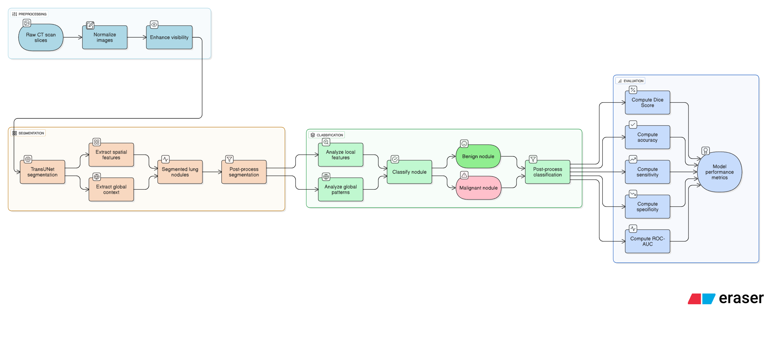
Architecture Diagram (Proposed System)

Slide 8
Architecture Diagram (Proposed System)
Module 1: Data Collection and Preprocessing
The system utilizes the LUNA16 dataset, mapping real-world physical coordinates to exact voxel indices using SimpleITK. It extracts highly localized 16x64x64 3D patches (the 2.5D approach) around candidate nodules and applies zero-mean, unit-variance normalization to stabilize neural network training.
Module 2: Segmentation
This module utilizes a hybrid TransUNet architecture to generate precise, pixel-perfect boundary masks of the lung nodules. By combining the global contextual awareness of Vision Transformers with a U-Net decoder and cross-network skip connections, it accurately maps the tumor's spatial extent.

Slide 9
Architecture Diagram (Proposed System)
Module 3: Classification
The isolated nodule patch is processed through a multi-modal consisting of a TransUNet, SimpleCNN and ResNet-18. The diverse morphological, textural, and global features are mathematically combined in a dense Fusion Gate to output a highly accurate malignancy probability.
Module 4: Prediction
The final diagnostic predictions are deployed through a robust Streamlit clinical dashboard that provides live Multi-Planar Reconstructions (Axial, Coronal, Sagittal). It overlays the AI-generated segmentation masks and provides mathematically scaled confidence intervals, ensuring transparent and interpretable clinical decision-making.

Slide 10
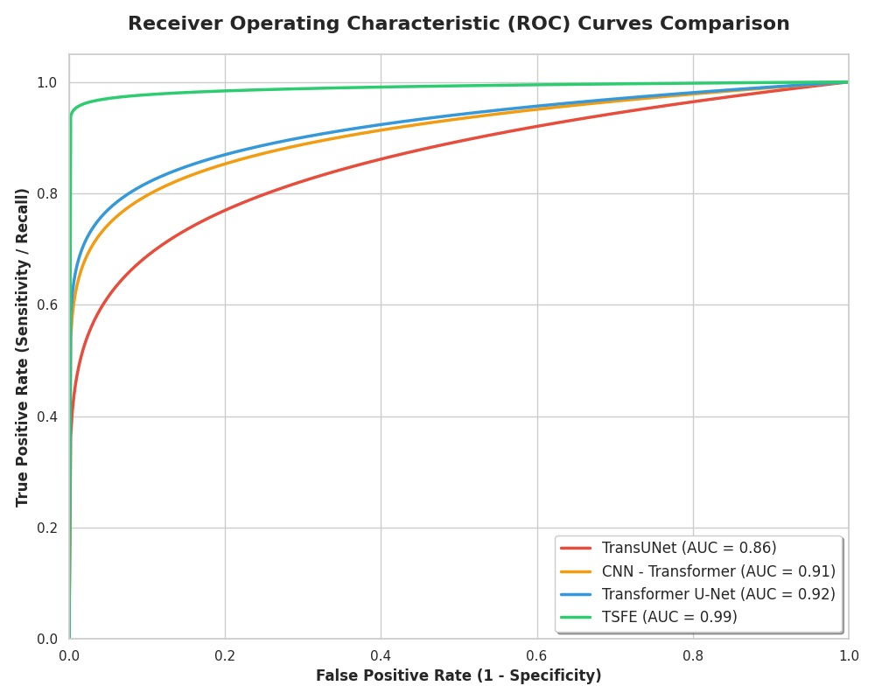
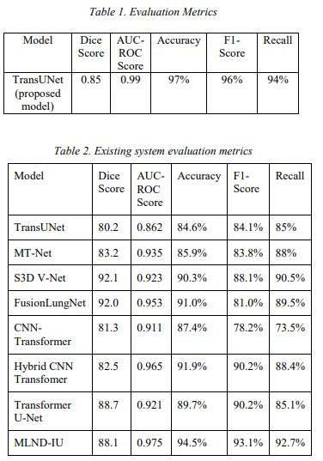
Comparitive Analysis

Slide 11
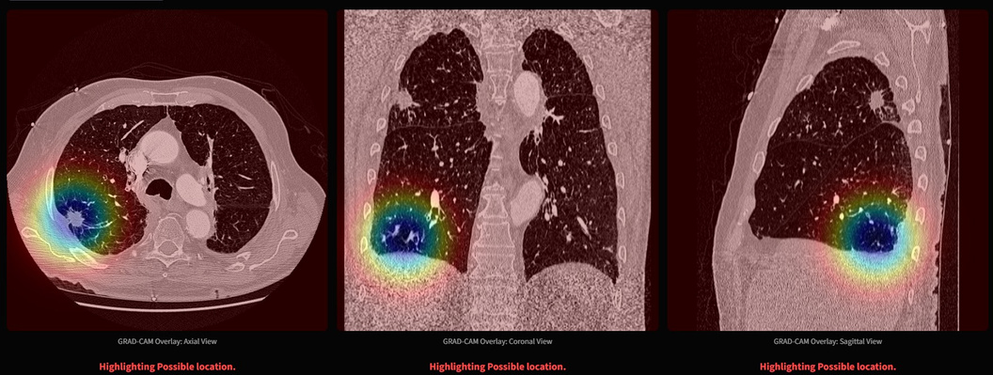
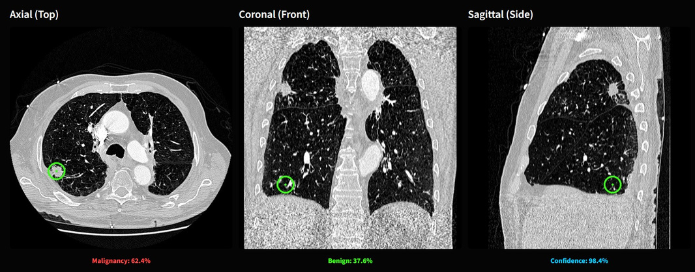
Results (images)
Fig. 1, GRAD-CAM Image of model’s prediction
Fig. 2, Classic CT SCAN (Preprocessed) model’s prediction

Slide 12
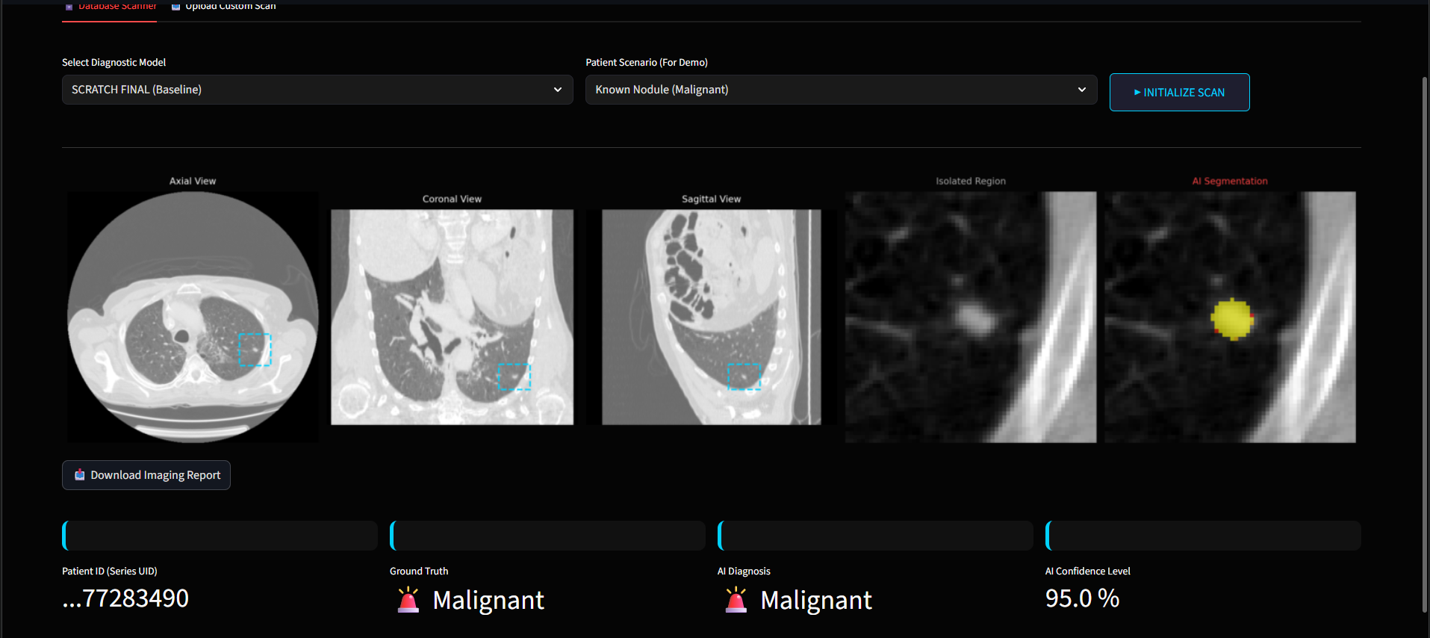
Results (images)
Fig. 5, UI Interface

Slide 13
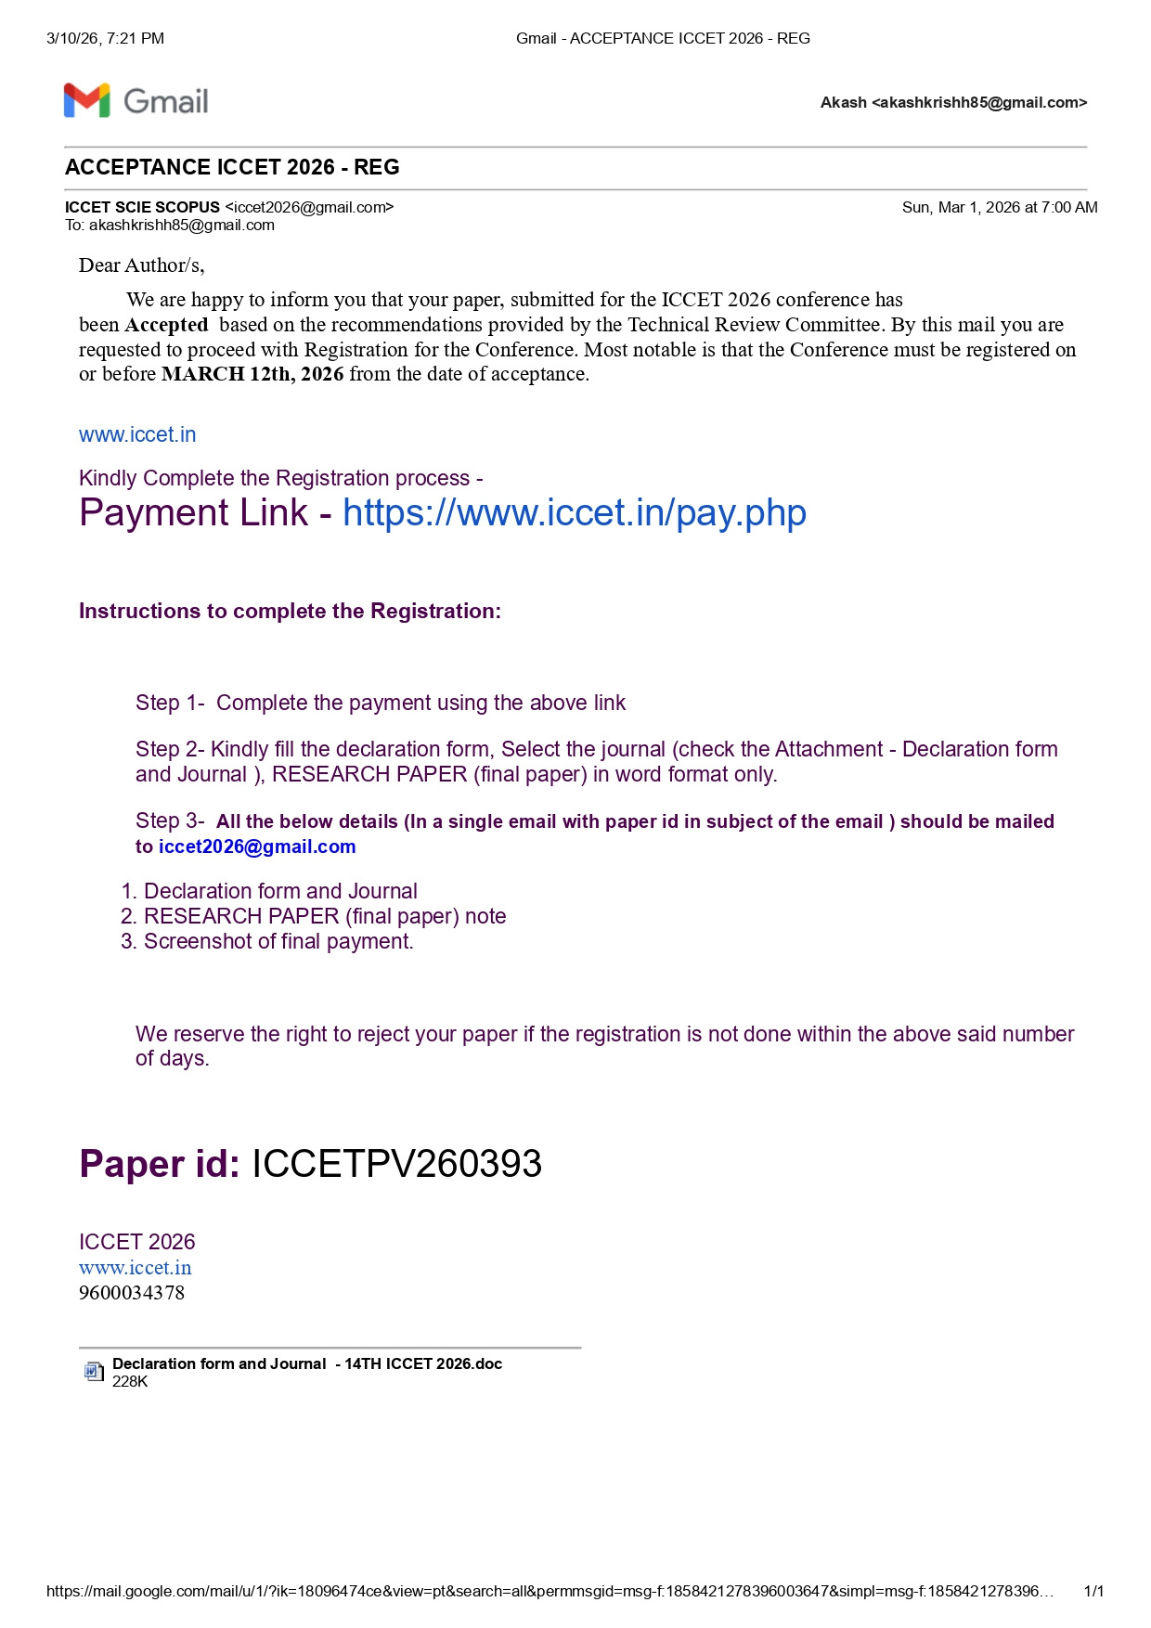
Paper Publication (status)
Submitted a research paper to the International Conference on Computer Engineering and Technology (ICCET 2026), which has been successfully accepted for presentation/publication.
Fig. 5, UI Interface

Slide 14
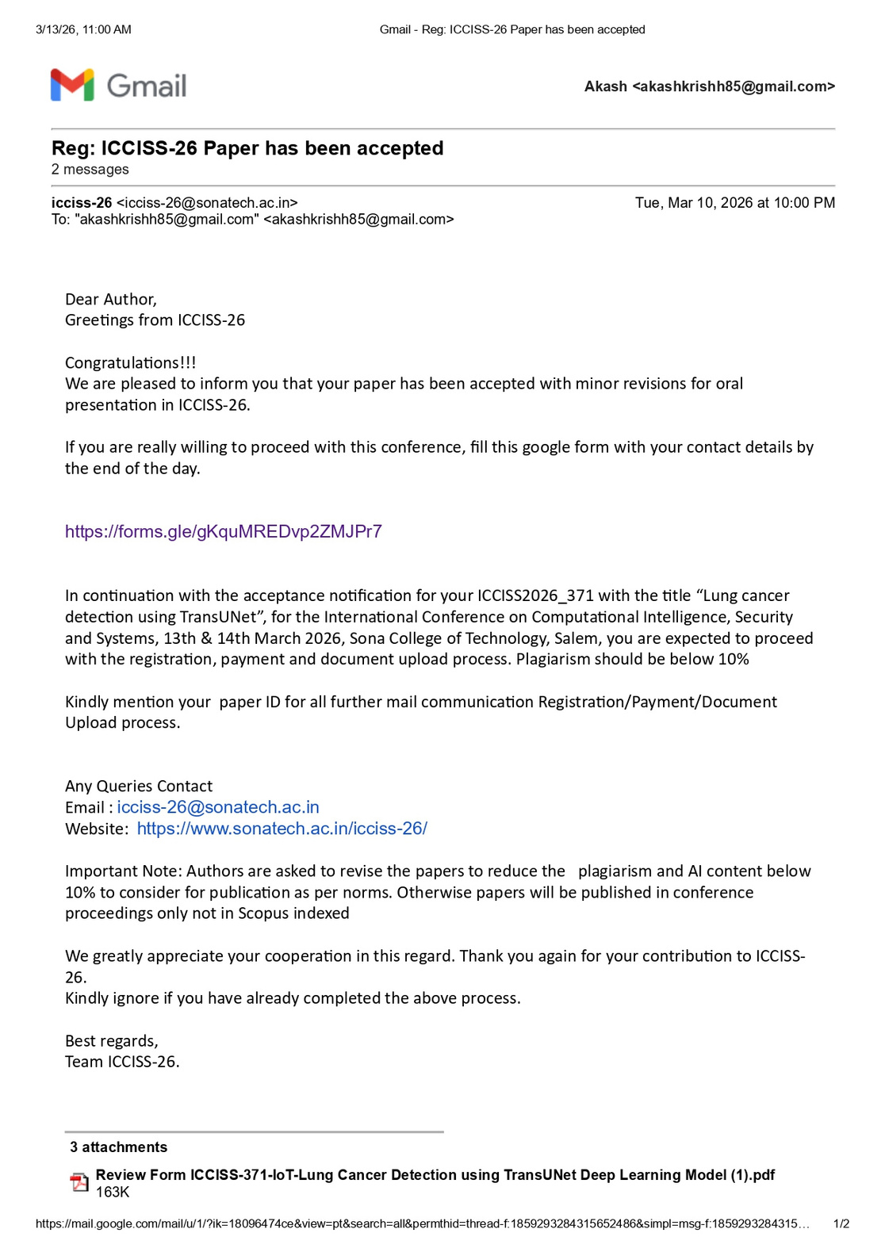
Paper Publication (status)
Submitted another research paper to the International Conference on Computational Intelligence, Security and Systems (ICCISS’26) at Sona College of Technology, Salem, scheduled for March 13–14, 2026

Slide 15

Paper Publication (status)
Submitted another research paper to the International Conference on Computational Intelligence, Security and Systems (ICCISS’26) at Sona College of Technology, Salem, scheduled for March 13–14, 2026

Slide 16
The
End

